Slide 1


HQ U.S. Air Force Academy
Cyber Operations Simulation Evaluator
C1C John Cavassa
C1C Ren Herbert
C1C Eric Johnston
‹#›

Slide 2
Who
Cadets sponsored by defense contractor
CUBIC
USAFA
Computer and Network Security Majors
Commission in May
AFSCs: 92T0
CS438/CS439 - Advanced Network Security Capstone
Sponsored by Capt. Susan Collins
‹#›

Slide 3
Why
Automated
Attack detection
Adjudication system
Real time
Modeled after kinetic strike evaluation
Currently the same does not exist for cyber environments
Flexible system needed
Work on all networks
Including Air Force Systems

Slide 4
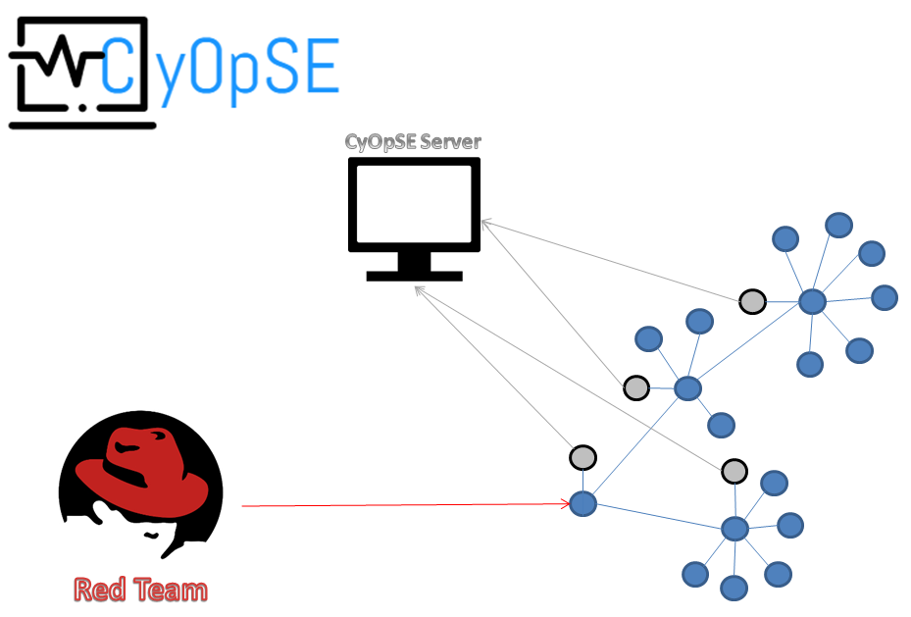
CyOpSE

Slide 5
What
CyOpSE
Real-time cyber effects adjudication implementation
Open source intrusion detection system
Powered by Bro IDS, Bro Control
Node architecture
Theoretically Expandable
Deployable on existing networks
Python server-client
Operates over private network
Detached from monitored network

Slide 6
What
Server side
Able to detect attacks IAW Mission Event Synchronization Lists
Parse created logs
XML
Updateable scripts
New exploits
Deploy on the fly

Slide 7
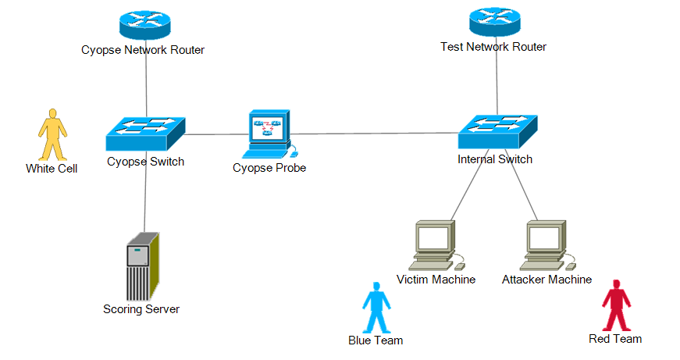
Testing Environment
Connected via spanning (mirroring port)

Slide 8
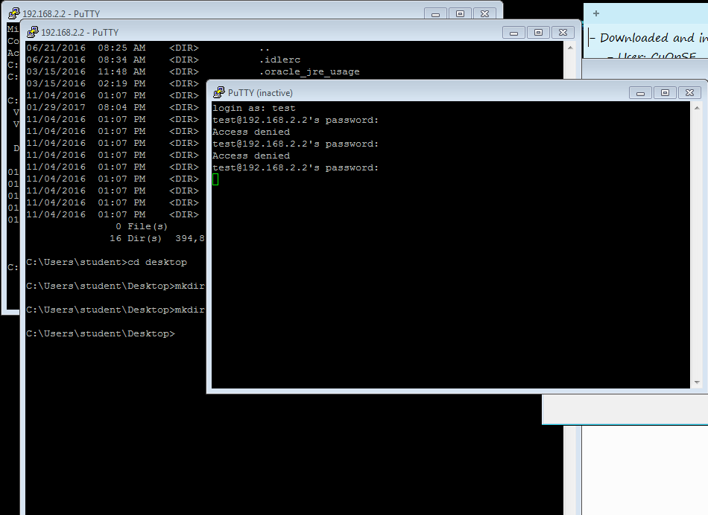
What We Have

Slide 9
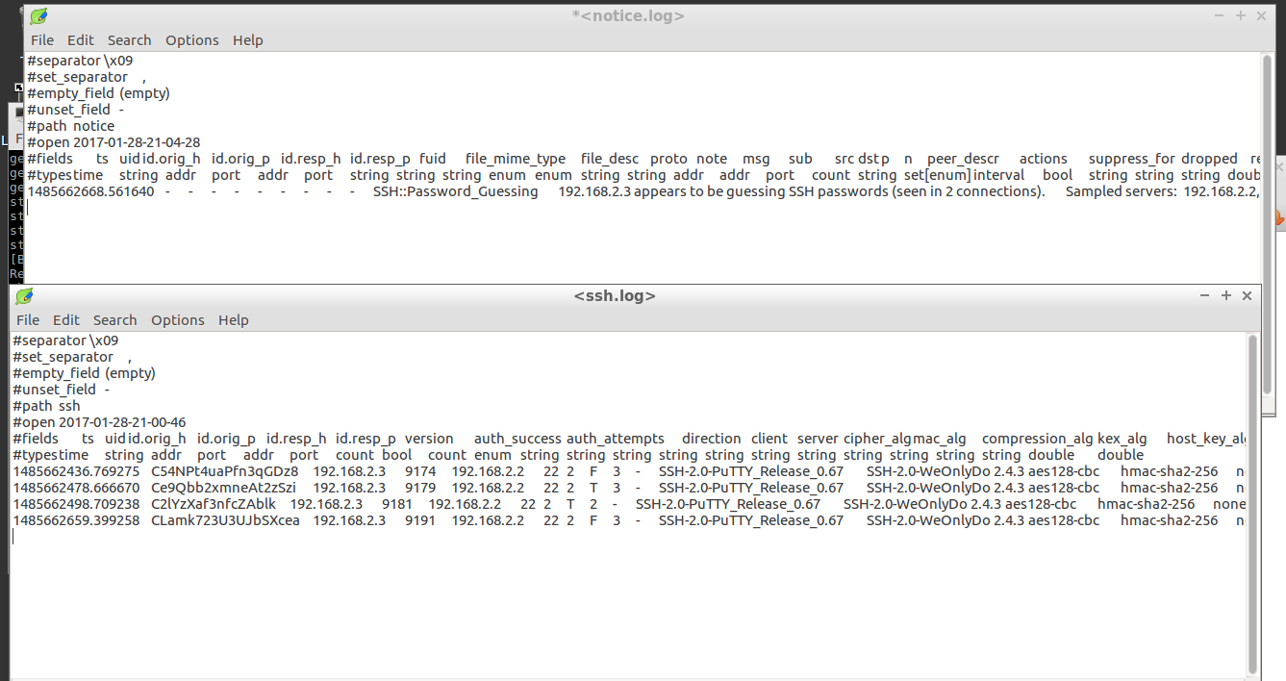
What We Have

Slide 10
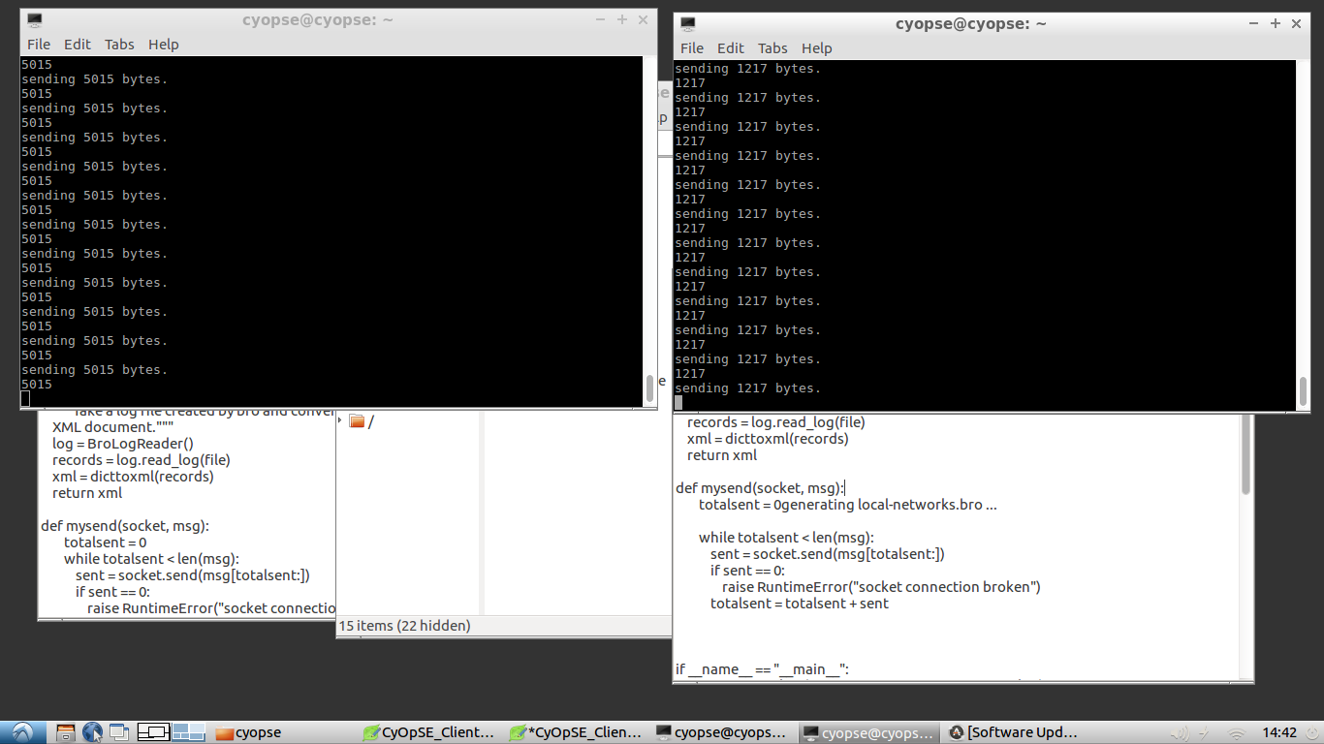
What We Have

Slide 11
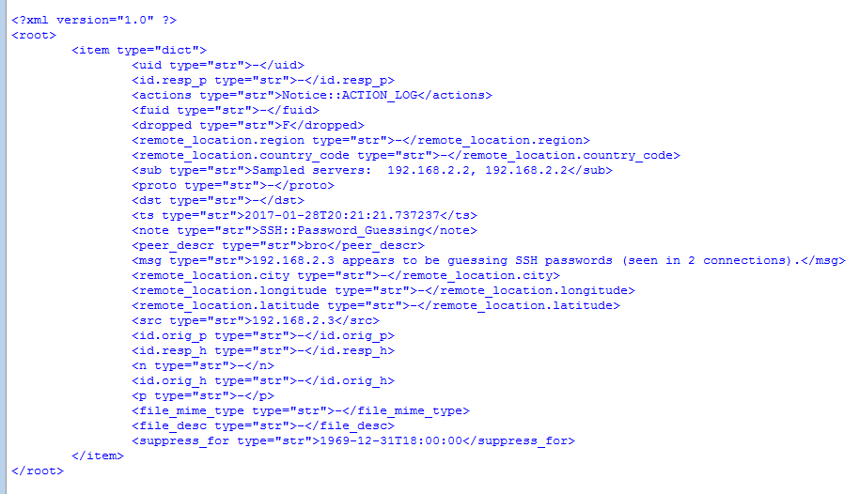

What We Have

Slide 12
When
Future CyOpSE implementations
Visualization
Website interface
Easily understood by commander
On the fly MESL creation
Updateable objectives
Rapid deployability
Plug and play
Efficient scoring methods
STiX formatting
‹#›

Slide 13
Recommendations
For the next team? For our progress this semester?
‹#›

